Slide 1
NIH ORF Contractor On-Boarding and Construction Requirements for the MACC Contract.
National Institutes of Health (NIH)
Office of Research Facilities (ORF)
3/5/2024
Note: Contents of these slides are of a general nature. You should review your Task Order for more detailed information and consult with your CO a/o COR/PO.

Slide 2
Welcome to our NIH Team
Office of Acquisition (OA)
MACC - Contracting Officer (CO) - Pete Miller
Design and Construction Management (DDCM)
MACC -Contracting Officer Representative
(COR) – Jim Ng

Slide 3
MACC Contractors
FBGC JV LLC
Puyenpa Services LLC
HSU Development INC
New Age Development Group LLC
Polu Kai Services, LLC
Cutlass Contracting LLC
Argus CJW JV 3 LLC
Belt Built-Protégé CFM
Four Tribes AIR JV LLC
Asturian-Consigli JV LLC
AG JV
Olgoonik Specialty Contractors LLC
Clark Construction Group
M.A. Mortenson Construction
Hensel Phelps
The Whiting-Turner Contracting Company

Slide 4
Welcome to the NIH MACC IDIQ
NIH is a great opportunity
NIH can be a challenging place to work
We are looking for partnerships with our construction contractors
Notes:
NIH is a great Business Opportunity
Direct contribution to the health of the Nation
Strong Congressional support and funding outlook
Construction program is on the upswing
NIH can be a challenging place to work
Stringent requirements, codes and standards, including the internationally-recognized NIH Design Requirements Manual
Extensive design reviews/ cross coordination
Worker training and security requirements
What are we looking for in a construction Partner
Excellent performance, quality and timeliness
Fair and reasonable prices
Commitment to Safety, especially:
Construction Risk Assessments
Interim Life Safety Measures
Infection Control
We pay in a timely manner in accordance with the Prompt Payment Act

Slide 5
NIH ORF Contractor On-Boarding and Construction Requirements Topic List
Fire - Paul Richards (FMD)
Physical Security - Larry Beverly (DPSM)
Building #10 CCC – Praveen Agarwal – (DDCM – Clinical)
Safety – Jim Ganz (Safety)
Environmental - Mark Miller (Dir DEP)
Badging and Parking Slides (PO)
Design Technical Review - Steve Breslin (DTR)
Equip. Numbering/Tagging - Sarkis Aktavoukian, DFOM Asset Management
OA MACC Contract Admin - Pete Miller (OA)
MACC COR – Jim Ng (Deputy DDMC)

Slide 6
Fire Protection and Life Safety

Slide 7
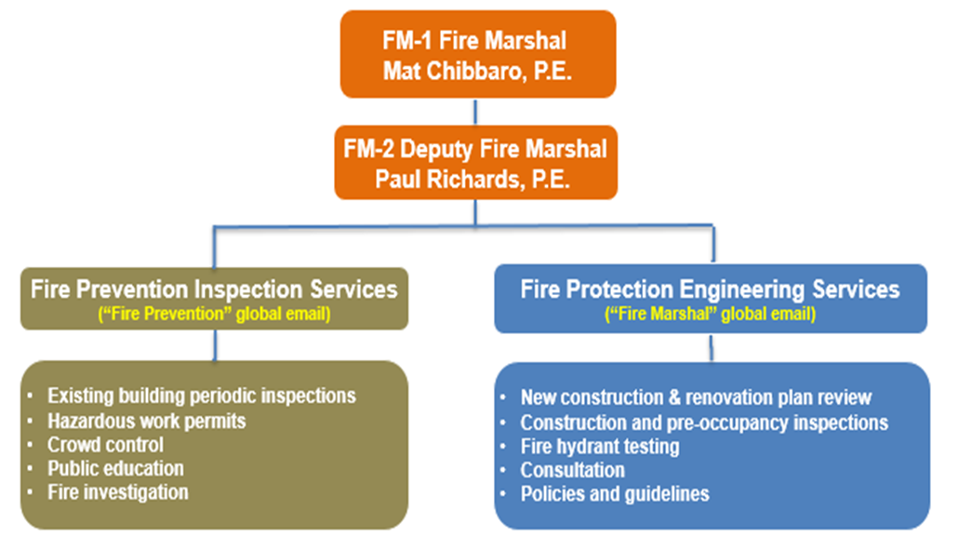
Fire Marshal Division (FMD) Organization Chart
Notes:
DFM created in 1987 with one engineer and 2 part timers from FD
Not under FD like many municipal FM operations
Qualifications & education of engineers & inspectors

Slide 8
DFM Partnership Responsibility
The DFM has been designated as the NIH’s “Authority Having Jurisdiction” (AHJ) as defined by the NFPA for all matters pertaining to fire protection and life safety Bethesda, Poolesville, RML, NIEHS and NCI at Fort Detrick.
Notes:
The DFM has been designated as the NIH’s “Authority Having Jurisdiction” (AHJ) as defined by the NFPA for all matters pertaining to fire protection and life safety for campuses shown
Rented facilities: consultative role (unlike DPSM)
EX: Montgomery County for Rockledge, Democracy

Slide 9
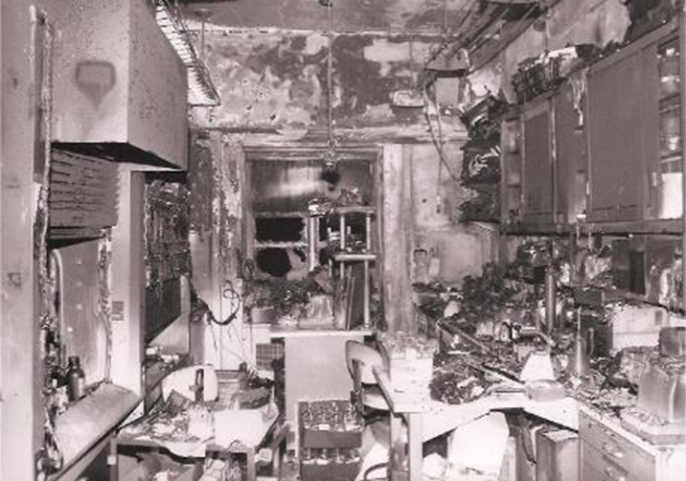
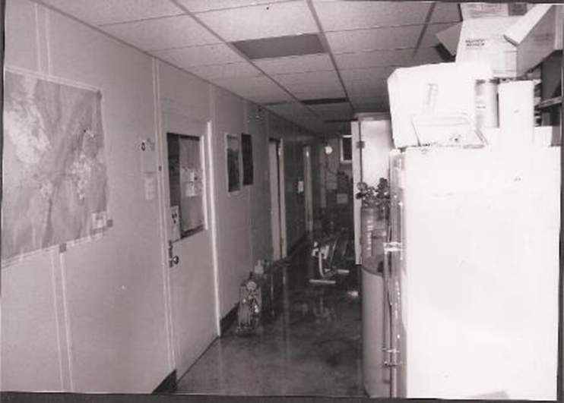
NIH Fire Damage photos

Slide 10
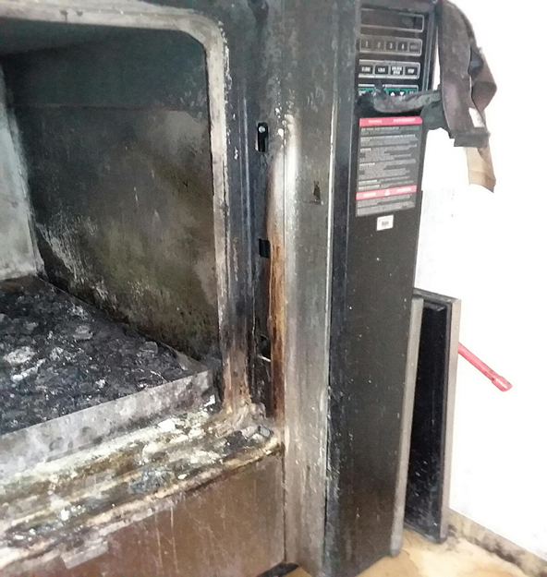
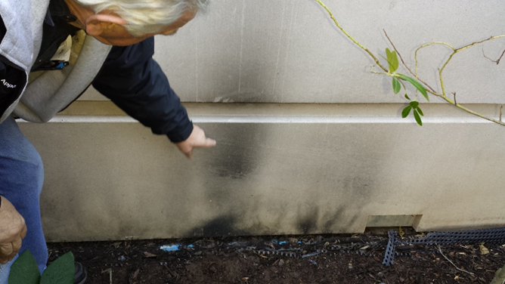
Indirect Cost of Incidents
Notes:
Indirect – beyond property loss
L – vacuum pump fire in Bldg 50 and took out backup pump and affected lab operations in entire building
UR – 2016 mulch fire caused by smoking on outside of CRC – smoke discovered inside – caused evac of 1 NW pediatric wing
LR – same mulch fire: FD opened up looking for source of fire before locating it outside; several patient rooms OOS for months

Slide 11

NIH DFM Requirements
Design & Review
  Design-Bid & Design-Build
  Small Activity Team
Construction & Inspection
Beneficial Occupancy
Final Inspection
Building 10 Requirements
Administrative Interpretations
Notes:
Difference between ‘Beneficial Occupancy’ and ‘Final Approval’

Slide 12
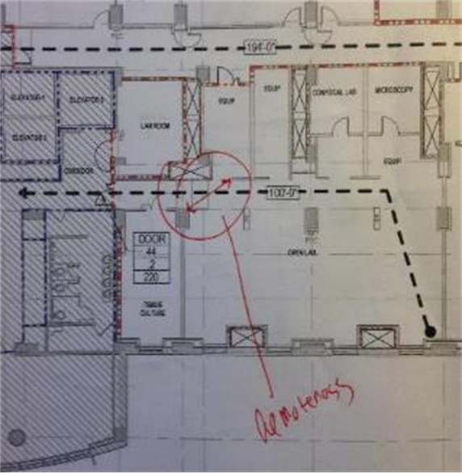
Design & Review
Design-Build & Design-Bid - Build
  Assistance in developing scope of work
  DFM reviews all design submissions
  Review valid for 1 year
  DFM reviews all design and scope amendments
Notes:
Let the DFM know what/when scope amendments occur to avoid issues during inspections

Slide 13
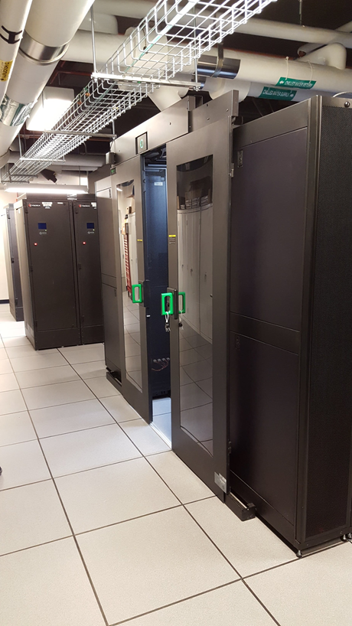
Design & Review - 1
Small Activity Team (SAT) Projects
  E-mail DFM scope and drawings
  Ask to schedule a walk and talk
Notes:
Always available for a walk-through to help answer any questions about the project requirements, assist in developing scope of work for FP and LS – ANY size project

Slide 14
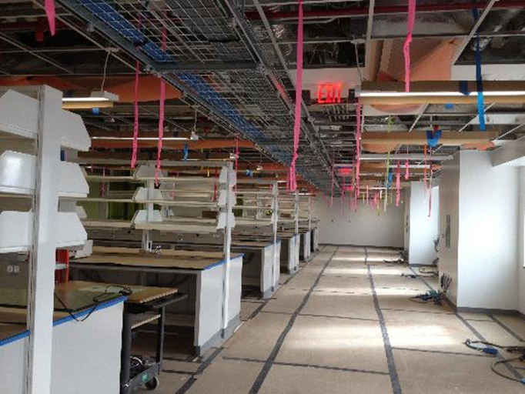
Design & Review - 2
2-week review time
Large projects may require a Fire Protection Engineering Analysis
Let DFM know if expedite is needed
Help hold A/Es accountable
Notes:
DFM does not provide design guidance, but can help with example ‘options’ or yes/no for code compliance
FPE analysis requirements come from the FDM
-Required for Change of Occupancy, New Buildings, New additions, Major Renovations
Accountable – code requirements

Slide 15
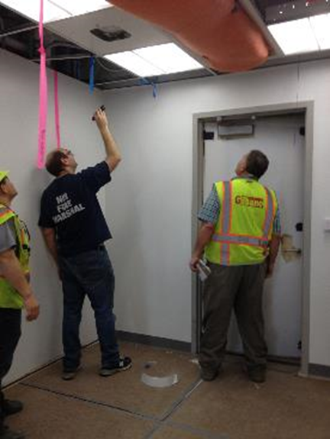
Construction & Inspection - 1
Wall Close-In
  Required for rated walls, shafts, smoke barriers, etc.
Ceiling Close-In
  Minimum 75% open for inspection
  Distinct sections can be phased
  Sprinkler and Fire Alarm submittals need to be approved prior to inspection
Submittals ( > 3 sprinklers/devices)
  2 weeks to review submittals
  Includes Sprinkler, Fire Alarm, Penetration Firestopping, etc.
Notes:
Can be phased for hard ceilings and bulkheads, certain rooms
Hot work permits

Slide 16
Construction & Inspection - 2
DFM reviews fire protection change orders
Allow for a 5 day inspection request time
Approved (DFM STAMPED) design plans need to be on site
PO or designee should be present for inspection
All parties including GC’s subcontractors need to be on site for testing
Forward DFM comments to contractors
Notes:
RFIs and change orders don’t always make it to us – let us help!
For sprinkler inspections, have sprinkler contractor present
For fire alarm, electrical contractor (to resolve minor issues on the spot)
On the stamped drawings the reviewer’s initials will be marked
Have red lined submittals on site

Slide 17
Fire Protection System ITM
      Sprinkler and Fire Alarm is under Project Officer Jin Kang
      ACEPEX / Reliance is the current maintenance Contractor
Notes:
Joe Stephenson retired
Dave Vashen and Mike Lanuotte Retired
Building 10 may not honor shutdowns on certain days due to staffing issues

Slide 18
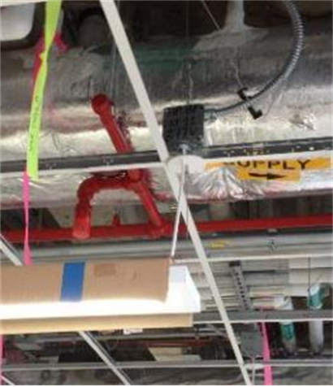
Fire Protection System Shutdown
Fire protection outage is not a substitute for inspection request to DFM
2-week request time for outages
    Use the shutdown form not work order form
Fire watch is for impairments of:
  Full Fire alarm Systems > 4 hours
  Partial Fire Alarm System > 4 or 10 hours
  Suppression Systems > 10 hours
Notes:
In healthcare, 4 hours is required for partial fire alarm system
OHPE provides fire watch in healthcare after 4 hours

Slide 19
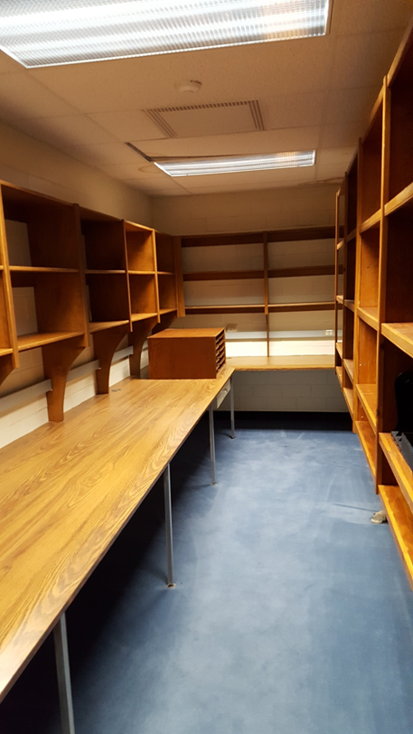
Beneficial Occupancy
Allows occupants in the space
Does not constitute final approval
Other disciplines may need to be finished prior to occupancy
Sprinkler and fire alarm as-builts are needed prior to contractor final payment
Notes:
Final punchlist items still need correction – minor – not imminent threat to life safety
DFM doesn’t speak for non-fire protection trades, such as air balancing

Slide 20
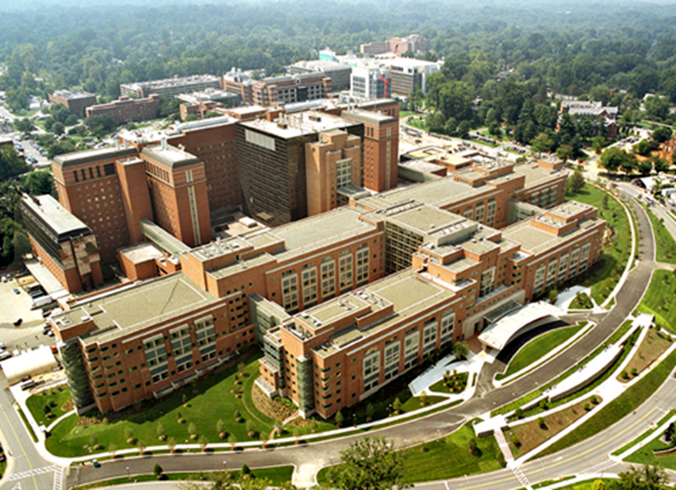
CRC / Building 10 Complex Reminders
Submit Project Notification Form
ILSM survey
Notes:
Project Notification required before design
PM will tell you if ILSM is required
ILSM required before Construction

Slide 21
Administrative Interpretations
Found on the DFM’s website:
  https://www.ors.od.nih.gov/ser/dfm/Pages/Administrative-Interpretations.aspx
  Google “NIH DFM Administrative Interpretations”
Covers
  Code Equivalency Requirements
  Shop Drawing Submittals
  Construction Separation

Slide 22
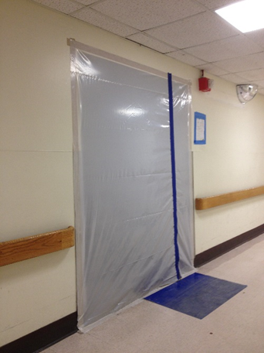
Construction Separation or Protection
Applies to Higher Hazard Construction
Any project <30 days
  Fire retardant plastic
Repair, renovation outside CRC > 30 days
  Fire retardant plastic
Modification or Reconstruction > 30 days
  See Admin Interp 17-4
  Allowances for existing walls
  Allowance for partial ceiling removal
Building 10:
  Comply with ILSM Requirements
  No option 2 above
  Fire watch if sprinkler is out of service

Slide 23
Recurring Issues
Design Drawings
DFM’s Scope
Work without Permits
Existing Deficiencies Uncovered During Construction

Slide 24
Design Drawings
Provide Life Safety Drawings
  Use NFPA 101 for Egress
NFPA and IBC Edition:
  As of “contract notice to proceed”
  2012 NFPA Life Safety Code for Joint Commission areas
Final Construction Drawings are Sealed

Slide 25
DFM’s Scope of Authority
Fire and Life Safety provisions only (DRM 9.1.2)
Notable exclusions include:
  Electrical
  Mechanical
  Structural
  Medical gases
  Fire service

Slide 26
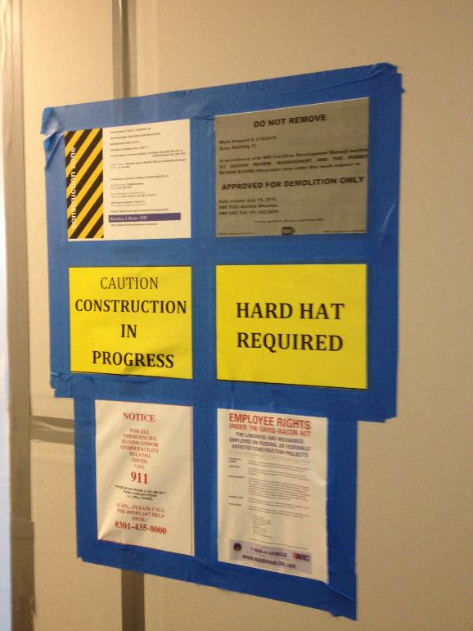
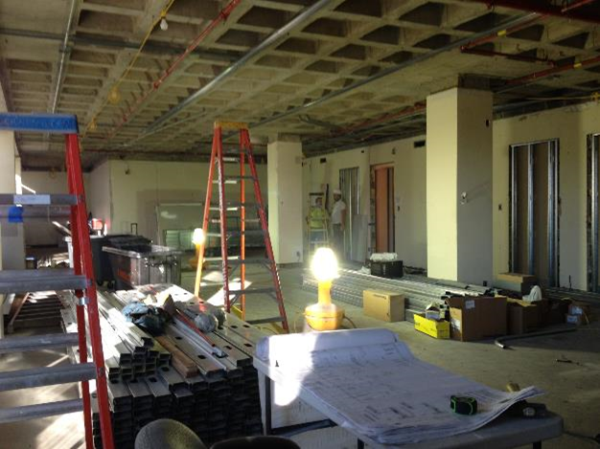
Work Permits Required
Notes:
Permits ensure work is done safely, surrounding areas adequately protected, and final product safe for occupancy

Slide 27
Existing Deficiencies Uncovered During Construction
Pre-design survey
Proper scope
Reduce change orders

Slide 28
Fire Marshall Contact Information
Contact DFM Engineers
  Email: ‘Fire Marshal’ in global
  Phone: 301-496-0487
  In person: Building 15G-2
Construction Plan Delivery
  Pick-up and drop-off by DTR
  Admin area on first floor 15G-2

Slide 29
Physical Security Project Requirements
Office of Research Services (ORS)
Security & Emergency Response (SER)
Division of Physical Security Management (DPSM)
October 16, 2019
John Petersen Director, DPSM

Slide 30
DPSM Mission
Our mission is to ensure all NIH facilities are protected against current and emerging threats by balancing high-quality, cost-efficient yet effective security systems and operations with federal mandates. Collaborating in this effort with the NIH community, we strive to achieve optimum results for a safe environment that does not restrict but promotes the mission and goals of the NIH.
Notes:
Systems include:
Access control devices (e.g. card/biometric readers)
Electronic surveillance and video recording systems
Protective walls, windows, and lighting systems
Emergency communication systems
Intrusion detection (alarm) systems
Blast analysis and mitigation techniques
Explosion and weapon detection screening
Vehicle and pedestrian barrier systems

Slide 31
Physical Security Definition
Physical security:
the protection of personnel, facilities, and information from physical actions and events that could cause serious loss or damage to an agency or institution. This includes but not limited to protection from an active shooter, insider threat burglary, and terrorism.
Notes:
Systems include:
Access control devices (e.g. card/biometric readers)
Electronic surveillance and video recording systems
Protective walls, windows, and lighting systems
Emergency communication systems
Intrusion detection (alarm) systems
Blast analysis and mitigation techniques
Explosion and weapon detection screening
Vehicle and pedestrian barrier systems

Slide 32
Physical Security Background
April 1995
October 1995
September 2001
2002
2003
Oklahoma City Bombing
E.O. 12977
September 11 Terrorist Attacks
OIG Report Findings
NIH Security Program Formed
Bombing of the Murrah Federal Building. Deadliest domestic terrorist attack at the time
Interagency Security Committee (ISC) created
World Trade Center
Pentagon
Shanksville, PA
Recommendation to improved the Security Program
Signed by NIH Director, Dr. Zerhouni
Outlines program elements and defines roles
Delegation of Chief Security Officer
Notes:
E.O 12977 - Focus on physical protection of Federal facilities
Institutes a process to assess and mitigate vulnerabilities , Oversees compliance, All non-DoD agencies must comply

Slide 33
NIH Policies and Guidelines
NIH Manual Chapter 1381
ORF
DPSM
Establishes policy, design requirements, standards and technical criteria for use in planning, programming, and designing NIH owned, leased, operated, and funded buildings and facilities.
Design & Requirements Manual (DRM)
Guidelines for security systems as it relates to new construction and renovation projects, security system standards and specifications for lifecycle projects
Policy & Design Requirements (PDR)
DPSM
Establishes a process to identify and obtain DPSM’s approval of the physical security requirements for alteration, construction, improvement, renovation, repair by replacement, and major equipment installation projects that take place in NIH owned and NIH leased facilities.
Notes:
Manual Chapter 1381
This policy establishes a process to identify and obtain DPSM’s approval of the physical security requirements for alteration, construction, improvement, renovation, repair by replacement, and major equipment installation projects that take place in NIH owned and NIH leased facilities. This policy will help ensure NIH physical security requirements are met and risks are mitigated. Any NIH organization that is planning the alteration, new construction, repair-by-replacement, renovation, or major equipment installation at NIH owned or NIH direct-leased facilities must coordinate with the Office of Research Facilities Development and Operations (ORFDO) and DPSM. Project Managers should consult with DPSM as early as possible during the initial project planning stages. Any additional contract impacts and unplanned physical security costs resulting from not receiving prior approval from DPSM will be borne by the offending organization.

Slide 34
Security Systems Include:
Access Control Devices and Components
Video Surveillance (CCTV) & Recording
Perimeter Security Intrusion Detection
Vehicle and Pedestrian Barriers
Building Hardening and Blast Mitigation
Facility Alarm System and Components
Notes:
Physical security systems at the NIH include:
Video surveillance systems (CCTV) and its components
Access control devices including card readers, dual-authentication readers and their components
Facility Alarm System (e.g. door & window contacts, motion sensors, keypads etc.)
Perimeter Security Intrusion Detection System – area fence
Vehicle Barriers and their components

Slide 35
DPSM Security Services
Design Review & Construction Inspections
Facility Security Assessments & Committees
Policy Reviews and Compliance Training
Systems Life Cycle Management

Slide 36
When to Contact DPSM
Projects that require the use of power or powder actuated tools and fasteners
  Permits and documentation required for use of tools or fasteners that could be weaponized or emit sounds similar to weapons
Construction tasks affecting security systems
  Activities that install, remove, modify, disable or hinder the performance of any physical security system or associated device
Projects that contain sensitive information
  Proper identification, distribution, and destruction of documents containing sensitive information
Notes:
Power and Powder Actuated Tools Permit
DPSM must be contacted prior to removing, relocating, or demolition of any security device, such as CCTV, card readers door contacts, intrusion detection contacts or security panels using DPSM Service Request.
Prior to performing any work on the fence or fiber on the fence, DPSM must be contacted. This includes removal of portions of the fence for a day or extended period of time. Any temporary gap in the fence must be protected/monitored by a guard or a temporary fence approved by DPSM
No standalone security systems
All security systems must be vetted by DPSM
All security devices and components must be TAA compliant

Slide 37
Before you begin work:
  Permit needed for Power and Powder Actuated Tools
  DPSM must be contacted prior to removing, relocating, or demolition of any security device, such as CCTV, card readers door contacts, intrusion detection contacts or security panels via DPSMService-Request@mail.nih.gov.
  Prior to performing any work on the fence or fiber on the fence, DPSM must be contacted. This includes removal of portions of the fence for a day or extended period of time. Any temporary gap in the fence must be protected/monitored by a guard or a temporary fence approved by DPSM
  No standalone security systems
  All security systems must be vetted by DPSM
  All security devices and components must be TAA compliant
Notes:
Power and Powder Actuated Tools Permit
DPSM must be contacted prior to removing, relocating, or demolition of any security device, such as CCTV, card readers door contacts, intrusion detection contacts or security panels using DPSM Service Request.
Prior to performing any work on the fence or fiber on the fence, DPSM must be contacted. This includes removal of portions of the fence for a day or extended period of time. Any temporary gap in the fence must be protected/monitored by a guard or a temporary fence approved by DPSM
No standalone security systems
All security systems must be vetted by DPSM
All security devices and components must be TAA compliant

Slide 38
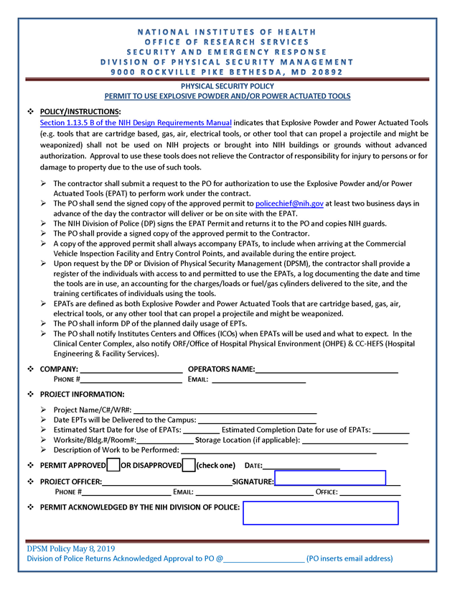
PERMIT TO USE EXPLOSIVE POWDER AND/OR POWER ACTUATED TOOLS

Slide 39
How to Contact Us
Building 45, Room 1AF10
301-827-4525
DPSM-ServiceRequest@mail.nih.gov

Slide 40
BUILDING #10 Clinical Center Complex (CCC)

Slide 41
Building #10 Clinical Center Complex
The Clinical Center Complex (CCC) is comprised of:
  Clinical Center (CC)
  Acute Care Research Facility
  (ACRF)
  Clinical Research Center (CRC)
At 4.6 M square feet, it is the largest clinical research hospital in the world.
It is occupied by 27 Institutes and Centers comprised of laboratory, patient care, clinic and admin areas.
This is a 24/7/365 operational building with continuous ongoing projects of various complexities.
Notes:
- The NIH CC only admits patients as part of clinical research studies
- Largest Federal Gov. building in gross SF, ~ 4.6 MSF
- Original building constructed in 1952, Clinical Research Center added in 2004
- There are currently about 1,500 clinical studies in progress at the Clinical Center
- 40 languages translated to support the global audience of patients, staff, visitors

Slide 42
Building #10 Clinical Center Complex- 1
All Design-Bid-Build and Design-Build project documents are reviewed and approved by ORF Division of Technical Resources (DTR).
Familiarity with the Design Requirements Manual(DRM) is essential.
Demo and Construction may proceed upon issuance of applicable Permits.
Limited staging area and Crane access areas.
All Hazmat work is performed by ORF Division of Environmental Protection (DEP) Contractors, prior to commencement of a project.
Safety clearance is also required.

Slide 43
Building #10 Clinical Center Complex- 2
All work in this Complex requires careful coordination both in the work area and adjacent spaces.
Processes you must be familiar with:
  Joint Commission Training (Annual) – Chris Loser, 301-496-3000
  Construction Risk Assessment (CRA)
  Interim Life Safety Measures (ILSM)
  Construction Above-Ceiling Work Permit
  Utilities Shutdown Approval – Planning meeting on every Weds @1PM, Bldg. 10, Room B1N108
  Fire Protection Systems Shutdown - Planning Meeting on every Tuesday @8AM, Bldg. 13, Rm 1416, Robert Belcher
  Other: After Hour Work Permit, Radiation Safety Training, etc.
Record documents will be provided but will require field verification.
Safety is priority one.
B2 Loading Dock (Memorial Drive) and pre-approved haulage and disposal routes.

Slide 44
Safety
Contractors are responsible for ensuring that both they and their subcontractors comply with the NIH Contractor Health and Safety Requirements, OSHA, and the Army Corps of Engineers EM385-1-1 safety regulations and standards.
Contractors shall register with the www.constructsecure.com database and address CASP scores below 80 before commencing work.
All contractors shall submit the following to safety@nih.gov:
  a fully completed Affirmation of Deliverables form signed by their principal and Site Safety and Health Officer (SSHO),
  the name and qualifications (i.e. resume, OSHA 30, etc.) of SSHO
  a Site Specific Accident Prevention Plan (SSAPP) specific to their scope of work with a completed ACE Form-A02 as a coversheet,
  a completed Activity Hazard Analysis form
At least one person on the jobsite will have attended the contractor health and safety orientation coordinated via Mr. Clarence Dukes and Mr. Chris Loser, within the last year.

Slide 45
Division of Environmental Protection
Note: Readers should also review the content of the ‘Environmental Compliance Requirements and Points of Contact at NIH Division of Environmental Protection (DEP)’ document that accompanies these slides for a more comprehensive list of environmental protection concerns.

Slide 46
Environmental - 1
C.5 - In the event that asbestos or any other hazardous materials are encountered in the course of the construction, the Contractor shall inform the CO and COR immediately to coordinate with the Division of Environmental Protection.
H.6.5 - The ORF Division of Environmental Protection (DEP) provides construction dumpsters for all construction and renovation projects on the Bethesda Campus at no cost. The dumpster rental, transportation, and disposal costs of all collected materials are covered by DEP. Before the dumpster will be delivered, the Contracting Officer Representative (COR) must submit a Site Selection Request and obtain approval.

Slide 47
Environmental - 2
H.6.8 - The contractor shall strictly follow all the conditions and requirements in the Maryland Department of the Environment (MDE)-approved drawings.
The installation of aboveground tanks for fueling the Contractor's equipment must be approved by the NIH Fire Prevention Section. Contractor shall provide secondary containment equipment for all fuel and/or chemical storage containers/tanks that meets Maryland Department of the Environment regulatory requirements.
Please review the Environmental Checklist that accompanies this presentation which has POC info.
The Division of Environmental Protection is located in Bldg 13. The phone number is (301) 496-7775.

Slide 48
Methods of obtaining a badge to access the NIH Bethesda Campus.

Slide 49
NIH Badging Process
- The Contractor shall provide information about all Contractor and subcontractor personnel and others who require continuing access to the site before access is required and when access ceases.
- No interviews of prospective Contractor employees shall be conducted within the project site or NIH property. The Contractor and subcontractors will be required to maintain a field office, outside the project site or NIH property, for all public contacts. Applicants for employment and other persons not entitled to access to the project site shall be required to contact the Contractor or subcontractor at these offices.
- Listings of Contractors requiring a physical presence on the NIH Campus will be maintained by the contractor. There are three methods of obtaining badges to access the NIH Bethesda Campus.

Slide 50
Method 1 – Daily Visitor Badge
Method 1 is a Daily Visitor Badge obtained through the NIH Gateway Center. Specific details can be found at Visitor Information | National Institutes of Health (NIH).

Slide 51
Method 2 – Extended Visitor Badge
Method 2 is a one-time only Extended Visitor Badge (EVB) for up to 6 months. If an EVB is issued it cannot be renewed. Consult with the COR/PO for specific details on applicability and process for application.

Slide 52
Method 3 – PIV Badge
Method 3 is a Personal Identity Verification (PIV) Badge for Contractor personnel that are anticipated to be on Campus more than 6 months. All PIV requests must be pre-approved by the Contractor and the Project Officer (PO). The requesting Contractor will submit for a PIV badge using the current HHS ID Badge Request HHS-745 and addendum forms. Submissions will follow the process outlined by the Division of Personnel Security and access Control (DPSAC). See DPSAC Process Overview (nih.gov). The submission of all badge applications must be encrypted safeguarding Personally Identifiable Information (PII). The NIH App, Secure Email File Transfer (SEFT), assists with transference of documents securely (https://secureemail.nih.gov/bds/Login.do).
Contractors are strongly encouraged to designate a Badging coordinator that can work with the PO’s badging coordinator to move requests through the process.

Slide 53
Parking at NIH

Slide 54
Parking for Contractor Employees
H.6.12 Parking Mitigation Plan - requires the Prime Contractor to submit a plan containing:
  Compliance with Category 1-4 parking restrictions – See next slides
  Site Plan identifying available parking on the Project Site and staging areas for construction vehicles and materials if designated in Task Order.
  Identification of Satellite Parking facilities as required.
  Identification of means to transport workers to project site as required.

Slide 55
Parking for Contractor Employees -1
H.6.11 Parking Regulations and Categories
  Category 1 - General Labor parking will be off-campus
  Category 2 - Specialty Contractors
    Includes smaller job contractors who work out of their vehicles for projects of short duration and no staging area is provided. (This would include elevator contractors, plumbing contractors, etc.).
    Specialty contractors shall use paid visitor lots. This cost shall be borne by the contractor.
    When it is essential that the specialty contractor's vehicle be in close proximity to the work area, the contractor may request special exception through the COR/PO.

Slide 56
Parking for Contractor Employees - 2
Category 3 - Contractors with Approved Staging Areas
  Includes contractors with approved staging areas. This would include general contractors as well as their subcontractors.
  Properly marked company vehicles and equipment required in the performance of their project shall be permitted to park within their approved staging areas. Personal vehicles are prohibited from parking within the staging areas.

Slide 57
Parking for Contractor Employees -3
Category 4 - Full Time CQM/A&E/Consultants for Design and Construction Activity
  Properly marked company vehicles required as part of their work shall be permitted to park within their approved staging areas. Personal vehicles are prohibited from parking within the staging areas.
  Personnel in a continuing role on construction sites may be provided parking permits in accordance with NIH parking policies by making a request through their COR/PO. A PIV Badge will also be required.
  Off-site CQM/consultant personnel shall use paid visitor parking areas.

Slide 58
H.6.10 Motor Vehicle and Parking Regulations
  When contractor trucks are to be parked for loading or unloading materials for a period longer than just a routine delivery, approval must be obtained from the Contracting Officer Representative (COR) who will notify the NIH Police.
  Vehicles operated over campus roads in connection with contract work shall be loaded so as to minimize spillage of dirt, gravel, and other debris.
  A vehicle accident shall be reported as soon as possible in person or by telephone to the NIH Police.
  When closing of roads or lots is necessary for a contractor to perform work, notify the COR/PO at least fourteen (14) calendar days in advance, so that the action may be cleared through the NIH Police and coordinated with affected tenants.

Slide 59
Division of Technical Resources (DTR)
Technical Design Reviews
Work Permit Review
Maintain and publish the Design Requirements Manual (DRM) and technical articles
Provide consultation

Slide 60
Division of Technical Resources (DTR) - 1
Technical Design Reviews:
  Submit documents to the DTR Intake Center
  Review by all applicable Divisions and Offices
  Documents reviewed for:
    The NIH Design Requirements Manual
    Latest codes and standards
    Completeness, constructability, best practices

Slide 61
Division of Technical Resources (DTR) - 2
Technical Design Reviews:
  Design review is not a quality control review for coordination within a particular discipline or between multiple disciplines
  Design review does not relieve designers from responsibility for the design

Slide 62
Division of Technical Resources (DTR) - 3
Work Permit Review Process:
  Review duration: Typically 10 business days for each submission
  A/E responses to comments – 5 business days

Slide 63
Division of Technical Resources (DTR) - 4
Work Permit Review Process:
  Comments provided, must be properly resolved prior to subsequent submission
  Reviews are by various NIH stakeholders – not a single group
  Permit issued for construction upon resolution of all comments

Slide 64
Division of Technical Resources (DTR) - 5
Design Requirements Manual (DRM)
Establishes policy, design requirements, standards and technical criteria for use in planning, programming and designing NIH owned, leased, and funded facilities

Slide 65
Division of Technical Resources (DTR) - 6
Design Requirements Manual (DRM) applies to:
  NIH owned facilities
  NIH occupied facilities, including Leases
  NIH funded facilities
  Universities and research institutions

Slide 66
Division of Technical Resources (DTR) - 7
Design Requirements Manual (DRM)
  See DRM Request for Variance process
  Use latest version of DRM at the time of notice-to-proceed. This is the version that will be enforced.
  Contact DTR for questions, comments, clarifications
  DRM is located at following website: https://www.orf.od.nih.gov/TechnicalResources/Pages/DesignRequirementsManual2016.aspx

Slide 67
Division of Facilities
Operations and Maintenance

Slide 68
Division of Facilities Operations & Maintenance (DFOM)
The Division of Facilities Operations & Maintenance (DFOM) is responsible for the safe, efficient, and effective operation and maintenance of NIH real property.
DFOM needs to know:
What existing equipment will be removed?
What existing equipment will be modified?
What new equipment will be installed?

Slide 69
Main Topics
Data Standard
Equipment Naming Convention
Equipment Unit Numbering Coordination
Equipment Tagging and Barcoding
Turnover Format

Slide 70
Data Standard
The following new data standard and process will be placed in future Task Orders as appropriate.
The CSI-based ORF Asset Hierarchy is the data standard for equipment naming, numbering, and tagging.
The COBie-based ORF Asset Attribute templates are the data standard for the key fields required for each equipment type.
The hierarchy and templates will be provided by DFOM.

Slide 71
Equipment Naming Convention
Equipment must be named according to the ORF Asset Hierarchy.
ORF leverages Construction Specifications Institute (CSI) classification for equipment.
The ORF Asset Hierarchy includes MasterFormat #s for each equipment type to ensure understanding across all parties.

Slide 72
Equipment Unit Numbering Coordination
During the design phase, DFOM will coordinate with the project officer and contractor for equipment unit numbering coordination.
The ORF Asset Hierarchy identifies the equipment types requiring numbering.
For existing equipment, DFOM will the provide existing equipment numbers for re-assignment.
For new equipment, DFOM will provide the equipment numbering convention and available range to ensure equipment numbers are not duplicated.

Slide 73
Equipment Tagging and Barcoding
If stated in the task order, the contractor may be responsible for tagging and barcoding equipment.
DFOM will provide the tag and barcode template for projects requiring tagging and barcoding.
The ORF Asset Hierarchy identifies which equipment types require tagging and barcoding.
The tag must include the assigned equipment number and the abbreviated equipment name, based on National CAD Standard (NCS), as identified on the ORF Asset Hierarchy.

Slide 74
Turnover Format
The final deliverable for equipment turnover includes the populated equipment templates and any documents associated with equipment (O&M Manuals, Warranties, Spare Parts, etc.).
The deliverable for equipment templates must be developed and turned over using the provided templates, in an excel-based spreadsheet format.
Any documents associated with equipment must be hyperlinked to the spreadsheet and turned over in a file folder structure. Documents must be in .pdf format.

Slide 75
Office of Acquisition

Slide 76
Office of Acquisition (OA) – Contract Admin
Only a warranted Contracting Officer (CO) acting within their delegated limits, has the authority to issue modifications or otherwise change the terms and conditions of the MACC and subsequently issued TOs.
If an individual other than the Contracting Officer attempts to make changes to the terms and conditions of the MACC or subsequently issued TOs, the contractor is hereby directed not to proceed with the change and immediately notify the Contracting Officer.

Slide 77
Expectations of MACC Contractor - 1
Be fair! We will be fair in return!
Be considerate and professional towards us the “Customer” and we will surely reciprocate
During solicitation, ask questions and point out ambiguity, force the Gov’t to answer the question/clear the ambiguity Do not rely on your own interpretation of an ambiguity (Patent vs Latent)
-In doing so you level the playing field; force your competition to propose on the same level of effort you are

Slide 78
Expectation of MACC Contractor - 2
Utilize the ORF FM 1 for change orders with supporting documentation
Be fair and reasonable in your proposals, especially with change orders, review subs proposals before they get to the Gov’t
  One of the many considerations that can effect a CPARs rating
CPARS Evaluation for Task Orders per Part 42 Threshold

Slide 79
Expectation of MACC Contractor - 3
If awarded, work within defined PoP and SOW/Spec/Drawings, DRM, etc….
  If you do not have the capacity don’t propose, just inform the CO, no harm
No exclusions will be accepted in proposals; everyone will propose on the same scope
We will only deal with the Prime (privy of contract)
  Subs are your business, so please act accordingly

Slide 80
Most Important Expectation
Most importantly we expect a quality product that is constructed in accordance with the solicitation documents that includes the DRM standards.

Slide 81
What to Expect from ORF
Fair opportunity to propose IAW with Part 16
Evaluation criteria that provides fair and reasonable method of having your proposal considered for award
Consideration/Equitable adjustment for changed or unforeseen conditions/work
Timely payments
Professional CO, CS, and CORs

Slide 82
Division of Design and Construction

Slide 83
Division of Design and Construction (DDCM) – MACC Contract Admin - 1
Please read Sections C, G and H of the Master MACC Contract:
  Section C – Description/Specifications
  Section G – Contract Administration Data
  Section H – Special Contract Requirements
Task Order (TO) documents may not repeat these requirements or information as they apply to all TOs.
Most of what you are hearing here today comes from these Sections of the Master MACC Contract.

Slide 84
Division of Design and Construction (DDCM) – MACC Contract Admin- 2
As the COR for the MACC Contract my responsibility is to ensure that the overall requirements of the Master Contract and subsequent Task Orders are achieved.
However, on a daily basis you will be working with the assigned individual COR/PO for that Task Order.
If there is a process issue/recommendation concerning the Master Contract or its provisions please contact me. If it is a matter for the Contracting Officer I will make that referral.

Slide 85
Division of Design and Construction (DDCM) – MACC Contract Admin- 3
The following are MACC Master Contract requirements that I want to particularly emphasize.
H.4.6 DELIVERABLES - All pre-construction deliverables shall be submitted prior to the commencement of work activities.
H.11 CONTRACTOR QUALITY CONTROL (CQC) PROGRAM – When specified provide the completed CQC Program to the COR/PO for review and approval within thirty days after TO award.

Slide 86
Division of Design and Construction (DDCM) – MACC Contract Admin-4
H.16.2 CONSTRUCTION SCHEDULE - Within ten (10) calendar days of receipt of the TO Notice to Proceed, or within the time set forth in the project specifications, the Contractor shall submit a proposed construction schedule for review and approval by the COR/PO. The construction schedule shall be approved in writing by the COR and CO before any site work is started.
H.5 SECURITY REQUIREMENTS - Develop and submit for approval a Contract/TO specific Contractor Security Plan. Designate in writing a Security Manager (SM).

Slide 87
Division of Design and Construction (DDCM) – MACC Contract Admin-5
All decisions and actions shall be documented by the Contractor via meeting minutes, RFIs, submittals and written correspondence as appropriate.
Role of IC POC - coordinate access to spaces, Locks, CIT, HazMat, Telephone, LAN, Locksmithing, Signage, Furniture, Punch lists, Post Construction activities. See IC Checklist at https://www.orf.od.nih.gov/Documents/ICGuidetoDesignandConstructioWorkflow508.pdf
Some work constraints are working hours, noise, dust/flying debris and trafficking through the adjacent facility.
There are work restrictions concerning Elevators, Cranes, Fueled Compressors, Power tools, Utility Shutdowns, Dumpster Program, Non-Smoking Campus, Trailers, Road Closures, Laydown areas, and Above Ceiling Permit (B#10)

Slide 88
Division of Design and Construction (DDCM) – MACC Contract Admin-6
The Contractor will be responsible for documenting (photo, video, instrument readings, etc.) existing condition such as ambient sound levels (especially in work areas adjacent to occupied spaces), wall and floor finishes, elevator, ceilings, HVAC, mechanical, electrical and plumbing equipment and lines.
Bi-Weekly Progress Meetings - COR/PO, IC POC, Contractor and relevant Subcontractors. The Contractor will report at progress meetings with an agenda and provide meeting minutes.
G.14 CPARS (Contractor Performance Assessment Reporting System). A final evaluation of the Contractor's performance shall be documented upon completion of each TO valued at more than $700,000. In addition to the final evaluation, interim evaluation(s) will be prepared annually as applicable and additionally as determined to be in the best interest of the Government.

Slide 89
Division of Design and Construction (DDCM) – MACC Contract Admin- 7
Closeout - Record Documents, O&M Manuals, Training/User Manual, Warranties/Guarantees Consolidated List, and Project Description/Construction Cost Data.(C.7.4)
Renovation work in laboratory areas cannot start until the work area has been certified by the ORS Division of Safety as being clear of any hazardous material.
The Contractor is to maintain Shop Vacuums in work areas in the event of water leaks. In addition, contractors shall have a Fire Sprinkler Shut off tool on hand in the event the work involves live sprinkler heads (H.4.13.k). Before beginning a task with live water pipes workers need to know the location of water shut off valves.

Slide 90
Division of Design and Construction (DDCM) – MACC Contract Admin- 8
Please work closely with your COR/PO, there is a significant learning curve if you have not worked at NIH before. The Campus has over 20,000 residents in 109 buildings on the Bethesda Campus alone.
There are 2,903 Fellows conducting research on campus, therefore you will most likely be working in occupied facilities with on-going activities. Any task that involves a disruptive event will require extra care. There are rigorous processes in place requiring permit approvals, stakeholder notices/coordination, and outage procedures for all such events that need to be carefully adhered to.
You have all been selected based on your consistently outstanding performance and professionalism and we are very glad to have you here and hope to develop strong working relations well into the future.

Slide 91
Acquisition
Contact Information
Office of Acquisition (OA)
MACC CO- Pete Miller - pete.miller@nih.gov
Design and Construction Management (DDCM)
MACC COR – Jim Ng ngj2@mail.nih.gov

